Slide 1
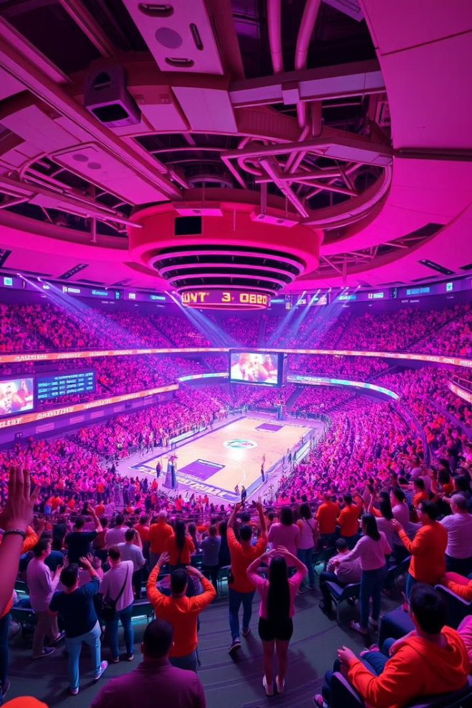
BasketBlock: Revolutionizing Sports Engagement
BasketBlock enhances sports fan engagement. It uses AI quizzes, NFT social media, and blockchain betting. It leverages the Electroneum blockchain and \$ETN token.

Slide 2
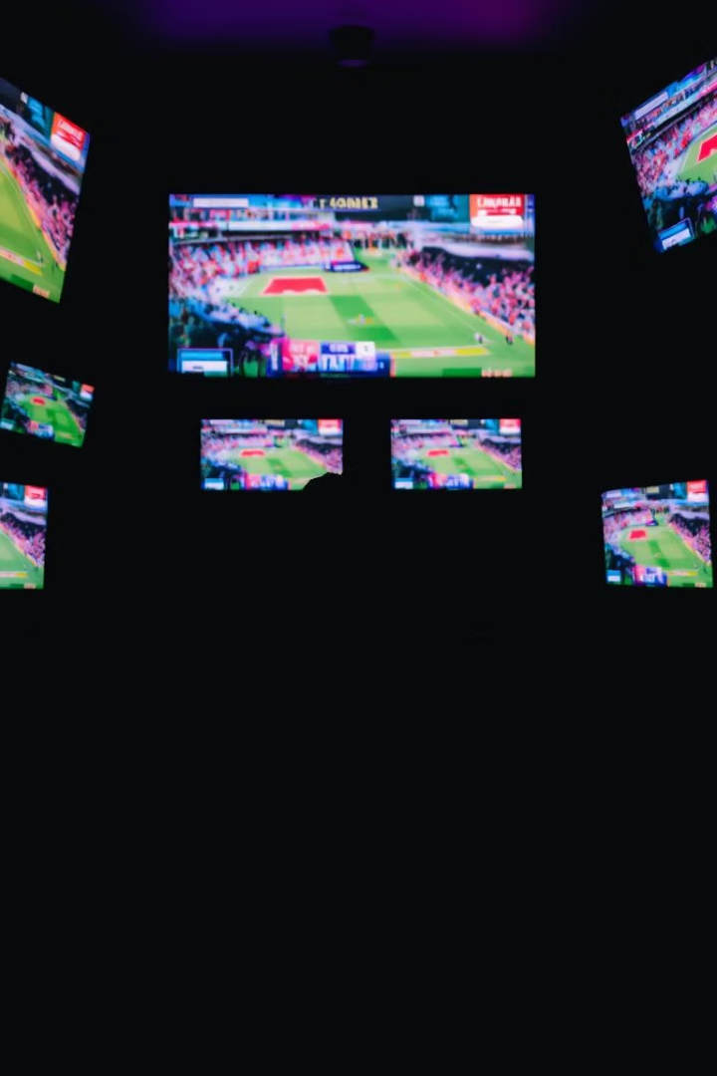
The Problem: Passive Engagement
1
Passive Engagement
2
Monetization Issues
Limited interaction beyond watching games.
Minimal control over earnings and assets.
3
Lack of Transparency
Traditional betting platforms are opaque.

Slide 3




Solution: BasketBlock ($ETN)
AI Quizzes
NFT Content
Smart Betting Pools
Engage with live NBA matches via real-time trivia.
Own, trade, or bet with auto-minted video NFTs.
Transparent pools for NFT auctions and bets.

Slide 4
Key Features
Video NFTs
AI-Powered Quizzes
Convert content into tradable NFTs.
Dynamic, real-time quizzes based on NBA data.
Auction via transparent betting pools.
Rewards fans with exclusive NFTs.

Slide 5

Technology Stack
Blockchain
AI
Electroneum for secure transactions.
Advanced models for quiz generation.
Frontend
TypeScript, modern framework.

Slide 6
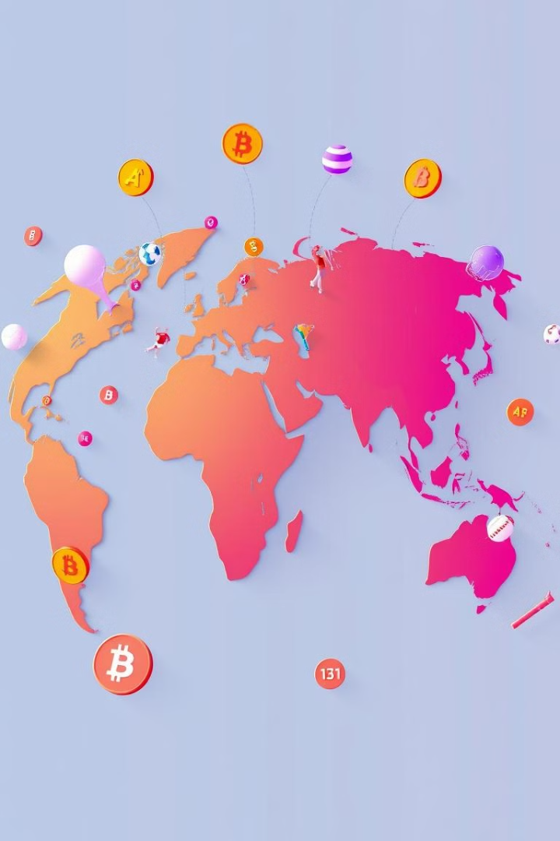
Market Opportunity
620B
35B
Global Sports Market
Blockchain in Sports
(2024)
(by 2027)
25B
NFT Market
(traded in 2021)

Slide 7
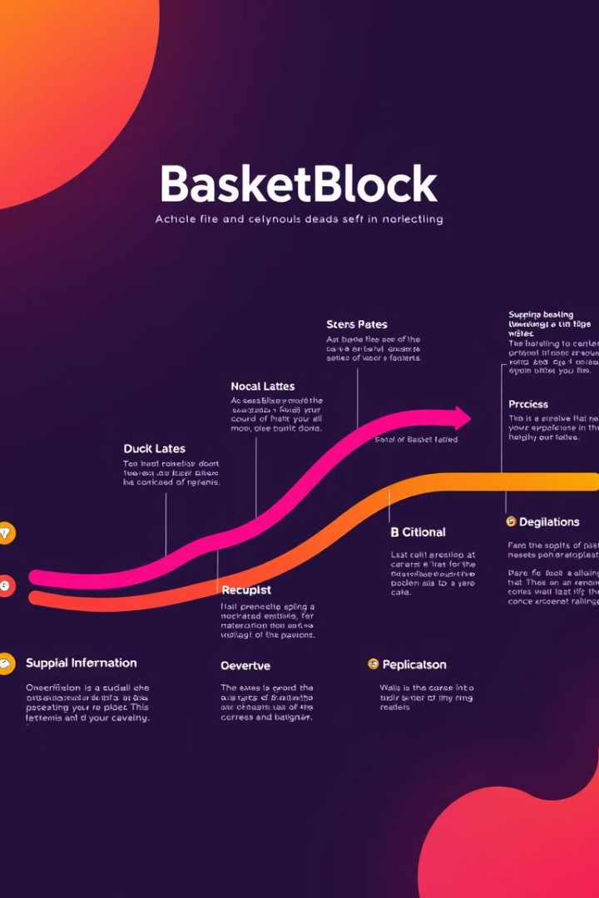



Revenue Model & Roadmap
NFT Auctions
Percentage of every sale.
Betting Pools
Fees on winnings and entries.
Subscription Plans
Premium access for features.

Slide 8



Competitive Advantage
2
Real-Time Engagement
AI quizzes linked to matches.
Fan Ownership
1
True ownership via NFTs.
Transparency
3
Smart contracts for transactions.

Slide 9
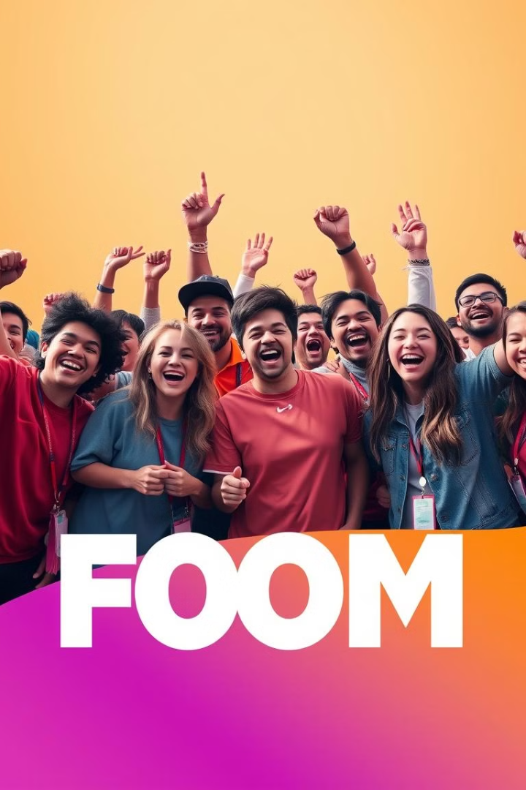
Conclusion
BasketBlock revolutionizes sports. It provides an immersive, interactive, and rewarding experience. It uses AI, NFTs, and blockchain technology. It offers a unique solution for sports enthusiasts.

